Slide 1
UNIT -3
CLOUD INFRASTRUCTURE

Slide 2
Cloud Platform Design Goals
Cloud Platform Design Goals Scalability, virtualization, efficiency, and reliability are four major design goals of a cloud computing platform.
Clouds support Web 2.0 applications.
Cloud management receives the user request, finds the correct resources, and then calls the provisioning services which invoke the resources in the cloud.
The cloud management software needs to support both physical and virtual machines.
Security in shared resources and shared access of data centers also pose another design challenge.

Slide 3
Cloud Design Objectives: Despite the controversy surrounding the replacement of desktop or deskside computing by centralized computing and storage services at the datacenters or big IT companies, the cloud computing community has reached some consensus on what have to be done to make cloud computing universally acceptable.
We list below six design objectives of cloud computing:
Shifting Computing from Desktops to Datacenters : The shift of computer processing, storage, and software delivery away from desktop and local servers to datacenters over the Internet.
Service Provisioning and Cloud Economics: Provider supply cloud services by signing SLAs with consumers and end users. The services must be resource economic with efficiency in computing, storage, and power consumption, etc. Pricing models are based on a pay-as-you-go policy.

Slide 4
Scalability in Performance: The cloud platforms and software and infrastructure services must be able to scale in performance as the number of users mounting.
Data Privacy Protection: Can you entrust the datacenters to handle your private data and records ? This concern must be addressed to make cloud successful as trusted services.
High Quality of Cloud Services: The QoS of cloud computing must be standardized to remove doubt over services provided to users. Cloud interoperability is required across multiple providers.
New Standards and Interfaces: This refers to solving the data lock-in problem associated with datacenters or cloud providers, Universally accepted APIs and access protocols are need to provide high portability and flexibility of virtualized applications.

Slide 5
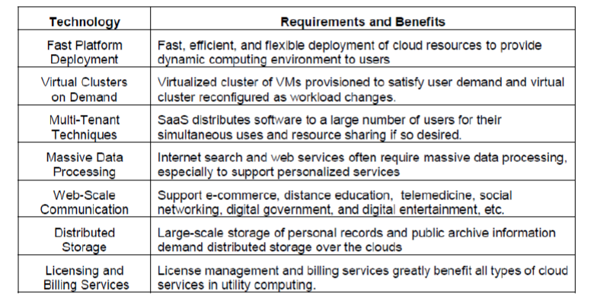
Various Enabling Technologies for Clouds:
The key driving forces behind cloud computing are the ubiquity of broadband and wireless networking, falling storage costs, and progressive improvements in Internet computing software.
Cloud users are able to demand more capacity at peak demand, reduce costs, experiment with new services, and remove unneeded capacity, whereas service providers can increase the system utilization via multiplexing, virtualization, and dynamic resource provisioning.
Clouds are enabled by the progress in hardware, software and networking technologies summarized in Table.

Slide 6
Cloud computing architecture refers to the components and subcomponents required for cloud computing. These components typically consist of a front end platform (fat client, thin client, mobile ),back end platforms (servers, storage), a cloud based delivery, and a network (Internet, Intranet, Intercloud).
An Internet cloud is envisioned as a public cluster of servers provisioned on demand to perform collective web services or distributed applications using data-center resources.
The cloud platform is formed dynamically by provisioning or de-provisioning servers, software, and database resources. Servers in the cloud can be physical machines or VMs. User interfaces are applied to request services.
The provisioning tool carves out the cloud system to deliver the requested service
In addition to building the server cluster, the cloud platform demands distributed storage and accompanying services.
The cloud computing resources are built into the data centers, which are typically owned and operated by a third-party provider.
Consumers do not need to know the underlying technologies. In a cloud, software becomes a service.
The cloud demands a high degree of trust of massive amounts of data retrieved from large data centers.

Slide 7
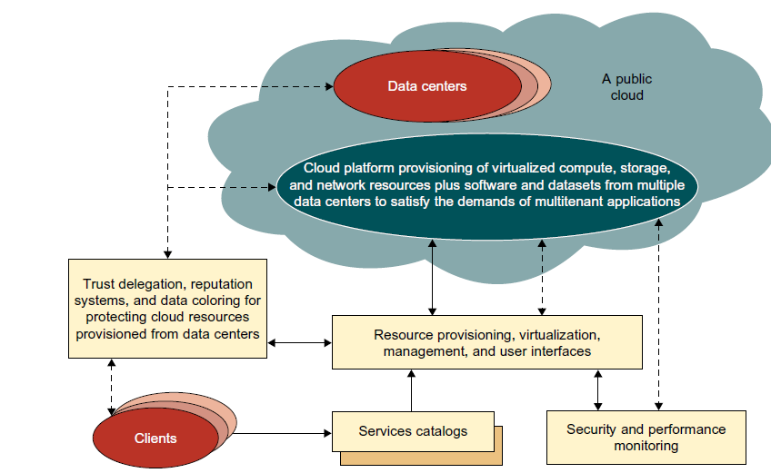
We need to build a framework to process large-scale data stored in the storage system.
This demands a distributed file system over the database system.
Other cloud resources are added into a cloud platform, including storage area networks (SANs), database systems, firewalls, and security devices.
Web service providers offer special APIs that enable developers to exploit Internet clouds.
Monitoring and metering units are used to track the usage and performance of provisioned resources.

Slide 8
The software infrastructure of a cloud platform must handle all resource management and do most of the maintenance automatically. Software must detect the status of each node server joining and leaving, and perform relevant tasks accordingly.
Cloud computing providers, such as Google and Microsoft, have built a large number of data centers all over the world.
Each data center may have thousands of servers. The location of the data center is chosen to reduce power and cooling costs.
Thus, the data centers are often built around hydroelectric power. The cloud physical platform builder is more concerned about the performance/price ratio and reliability issues than shear speed performance.
In general, private clouds are easier to manage, and public clouds are easier to access.
The trends in cloud development are that more and more clouds will be hybrid. This is because many cloud applications must go beyond the boundary of an intranet.
One must learn how to create a private cloud and how to interact with public clouds in the open Internet.
Security becomes a critical issue in safeguarding the operation of all cloud types

Slide 9
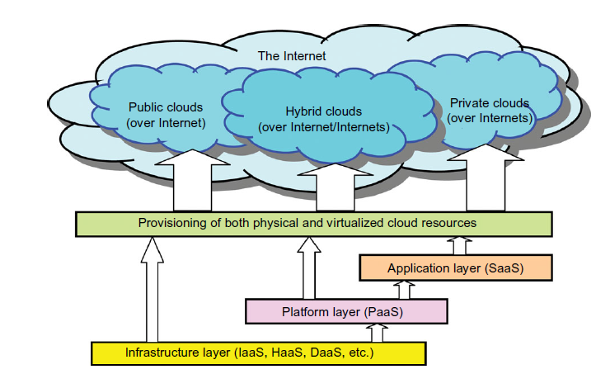
Layered Cloud Architectural Development
The architecture of a cloud is developed at three layers: infrastructure, platform, and application, as demonstrated in Figure .
These three development layers are implemented with virtualization and standardization of hardware and software resources provisioned in the cloud.
The services to public, private, and hybrid clouds are conveyed to users through networking support over the Internet and intranets involved.

Slide 10
It is clear that the infrastructure layer is deployed first to support IaaS services. This infrastructure layer serves as the foundation for building the platform layer of the cloud for supporting PaaS services. In turn, the platform layer is a foundation for implementing the application layer for SaaS applications.
The infrastructure layer is built with virtualized compute, storage, and network resources. The abstraction of these hardware resources is meant to provide the flexibility demanded by users. Internally, virtualization realizes automated provisioning of resources and optimizes the infrastructure management process.
The platform layer is for general-purpose and repeated usage of the collection of software resources. This layer provides users with an environment to develop their applications, to test operation flows, and to monitor execution results and performance. The platform should be able to assure users that they have scalability, dependability, and security protection.
In a way, the virtualized cloud platform serves as a “system middleware” between the infrastructure and application layers of the cloud.

Slide 11
The application layer is formed with a collection of all needed software modules for SaaS applications. Service applications in this layer include daily office management work, such as information retrieval, document processing, and calendar and authentication services.
The application layer is also heavily used by enterprises in business marketing and sales, consumer relationship management (CRM), financial transactions, and supply chain management.
It should be noted that not all cloud services are restricted to a single layer. Many applications may apply resources at mixed layers.
After all, the three layers are built from the bottom up with a dependence relationship.
From the provider’s perspective, the services at various layers demand different amounts of
functionality support and resource management by providers. In general, SaaS demands the most work from the provider, PaaS is in the middle, and IaaS demands the least.
Example of this is the Salesforce.com CRM service, in which the provider supplies not only the hardware at the bottom layer and the software at the top layer, but also the platform and software tools for user application development and monitoring.

Slide 12
Market-Oriented Cloud Architecture
As consumers rely on cloud providers to meet more of their computing needs, they will require a specific level of QoS to be maintained by their providers, in order to meet their objectives and sustain their operations.
Cloud providers consider and meet the different QoS parameters of each individual consumer as negotiated in specific SLAs. To achieve this, the providers cannot deploy traditional system-centric resource management architecture.
Instead, market-oriented resource management is necessary to regulate the supply and demand of cloud resources to achieve market equilibrium between supply and demand.
The designer needs to provide feedback on economic incentives for both consumers and providers.
The purpose is to promote QoS-based resource allocation mechanisms. In addition, clients can benefit from the potential cost reduction of providers, which could lead to a more competitive market, and thus lower prices.

Slide 13
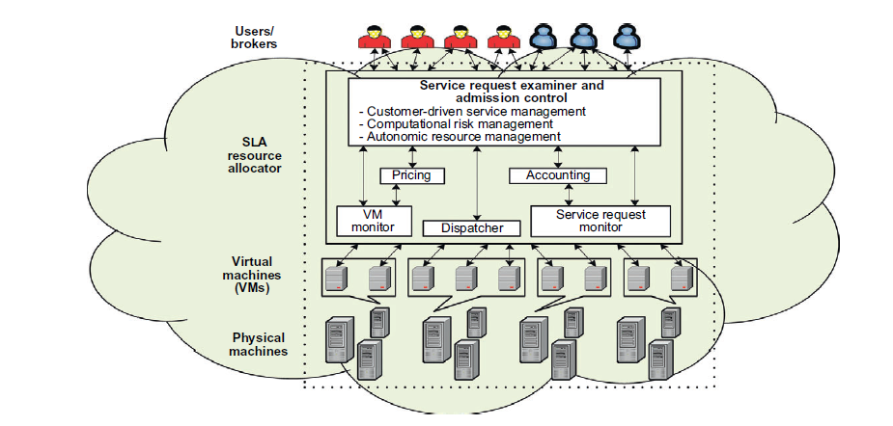
Figure shows the high-level architecture for supporting market-oriented resource allocation in a cloud computing environment
This cloud is basically built with the following entities:
Users or brokers acting on user’s behalf submit service requests from anywhere in the world to the data center and cloud to be processed.
The SLA resource allocator acts as the interface between the data center/cloud service provider and external users/brokers

Slide 14
It requires the interaction of the following mechanisms to support SLA-oriented resource management.
When a service request is first submitted the service request examiner interprets the submitted request for QoS requirements before determining whether to accept or reject the request.
The request examiner ensures that there is no overloading of resources whereby many service requests cannot be fulfilled successfully due to limited resources.
It also needs the latest status information regarding resource availability (from the VM Monitor mechanism) and workload processing (from the Service Request Monitor mechanism) in order to make resource allocation decisions effectively.
Then it assigns requests to VMs and determines resource entitlements for allocated VMs.

